Slide 1
EcoFracNet plot design
Site naming scheme
BTO Breeding Bird Survey grid cell
111
112
121
122
211
212
221
222
900m
900m
113
123
213
223
131
132
231
232
133
100m
233
100m
300m
300m
311
312
321
322
313
323
331
332
333
required plots
optional plots
required plots
optional plots
Note: numbers go clockwise from 1, starting at the top-left triangle at each ‘level’ of a triad. Thus the top-left sites all start with a ‘1’, and the top-left within those with ‘11’.

Slide 2
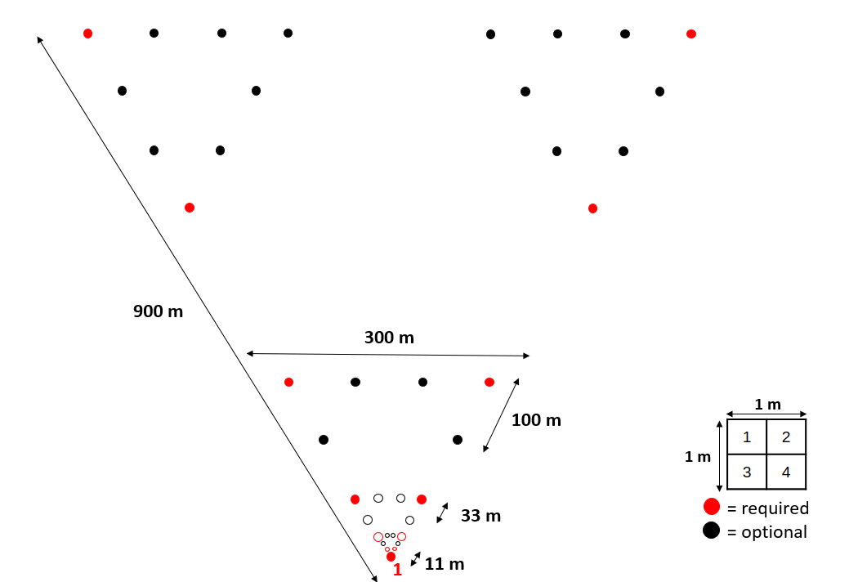
MicroFracNet plot design

Slide 3
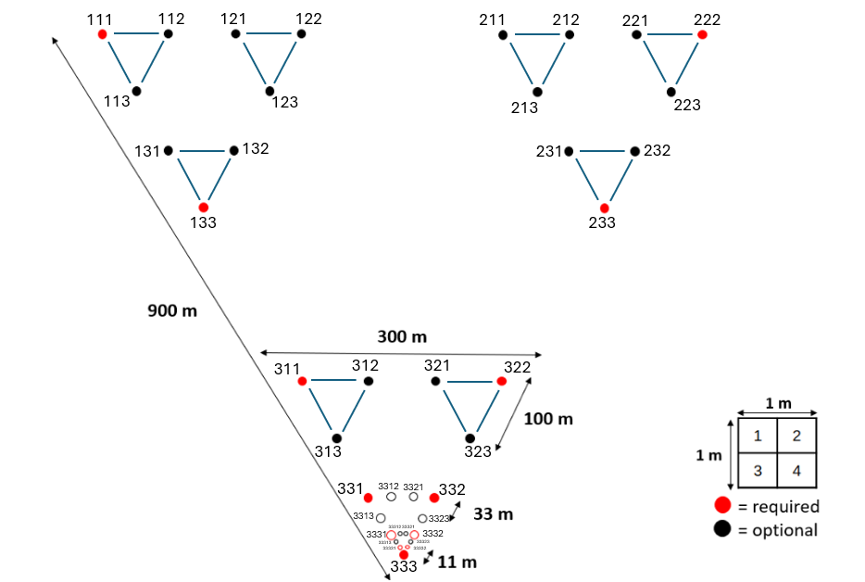
MicroFracNet plot design
Note: numbers go clockwise from 1, starting at the top-left triangle at each ‘level’ of a triad. Thus the top-left sites all start with a ‘1’, and the top-left within those with ‘11’. For a zoom-in of the bottom triangle, see next slide.
Numbering is chosen so that location of a plot within the design is harder to mess up.

Slide 4
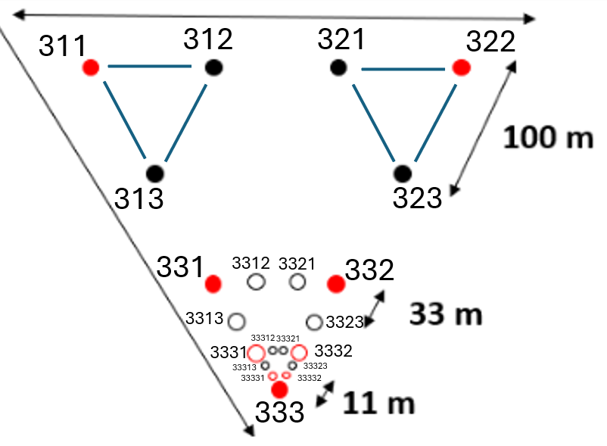
MicroFracNet plot design – zoom in
Note: numbers go clockwise from 1, starting at the top-left triangle at each ‘level’ of a triad. Thus the top-left sites all start with a ‘1’, and the top-left within those with ‘11’. For a zoom-in of the bottom triangle, see next slide.

